Slide 1
AN INTRODUCTION TO FIGSHARE REPOSITORY PLATFORM
WALTER SISULU UNIVERSITY
Library Information Services

Slide 2
Background
Figshare is live at WSU:
We wish to encourage the university community to use the platform to:
manage research data,
collaborate with others on projects
and/or to create personal or group collections of research work that can be kept private or public for other researchers to benefit from.
Figshare features aim to help you organize your research and get as much impact for it as possible, without adding time or effort to your day (Source: https://figshare.com/features).

Slide 3
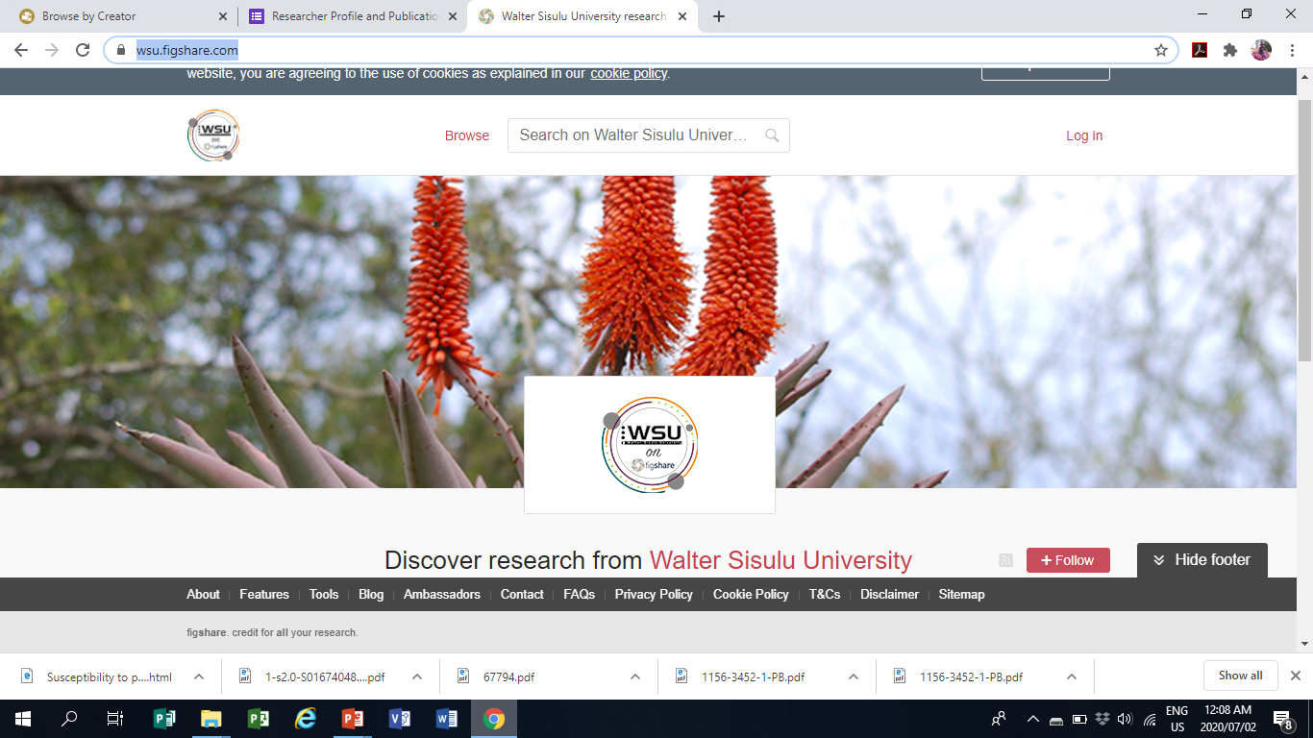
How To Access It
Go to: https://wsu.figshare.com/

Slide 4
Features

Slide 5
Features (Continued)

Slide 6
Features (continued)

Slide 7
Features (continued)

Slide 8
Click the login button on the top left

Slide 9
WSU login account needed

Slide 10
My data tab
In order to upload your research data: How to upload and publish your data
https://knowledge.figshare.com/articles/item/how-to-upload-and-publish-your-data

Slide 11
Projects tab
Click to upload a project
How to use projects and collaborate on Figshare
https://knowledge.figshare.com/articles/item/how-to-use-projects-and-collaborate-on-figshare

Slide 12
Collections tab
Click to create a new research collection for yourself, department, faculty, unit or directorate
In order to learn how to create and use a new collection, use the link below:
https://knowledge.figshare.com/articles/item/how-to-use-collections

Slide 13
Activity tab
This tab allows to view a list of outstanding items that requires the user attention at a given time

Slide 14
More guidance on figshare
How-To Guides
https://knowledge.figshare.com/articles/how-to-guides

Slide 15
Contact details FOR HELP
For Figshare related queries, please email or call:
Mr. Adelin Kantore
Email: akantore@wsu.ac.za
Cell: +27- 748298019

